Slide 1





LMS
APPLICATION
LAUNCHING
PRESENTATION

Slide 2
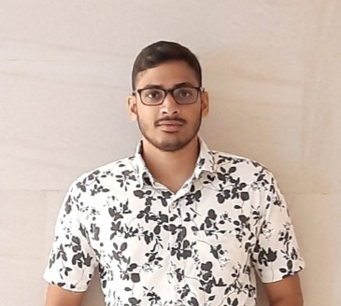

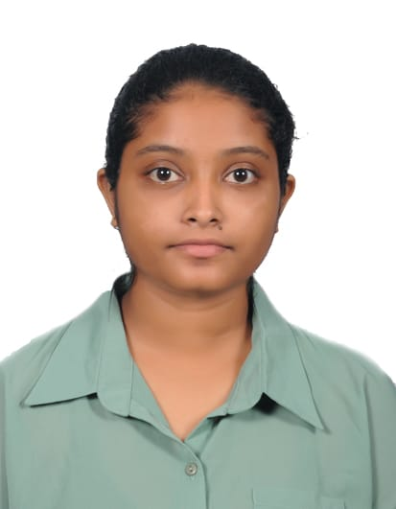


OUR TEAM
Ravindu Mallikarachchi
Asirimath Vimukthi
Bihara Numanashi
Yashasvi Gunasekara
Themira Avishanka
Karindra Chamika

Slide 3

CONTENT LIST
PRESENTATION
01.
02.
03.
OPENING
ABOUT APP
APP USAGE
Briefly elaborate on the background.
Explaining about app scope
Briefly explain App Functionalities

Slide 4
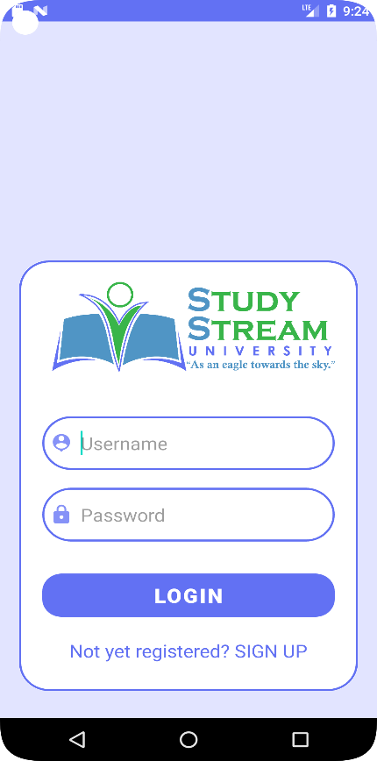

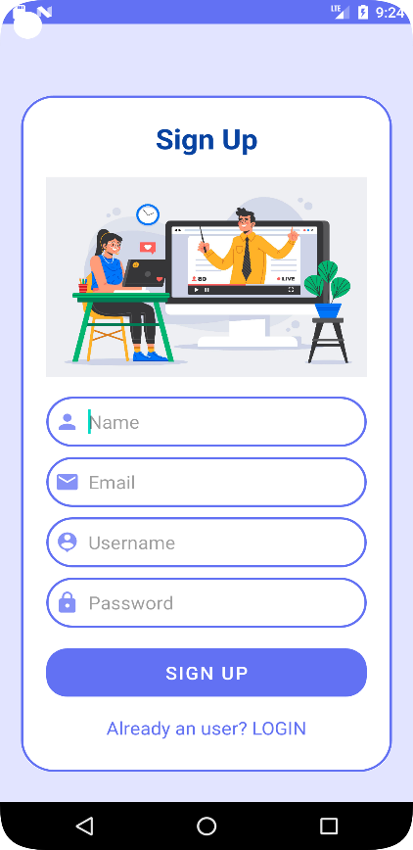
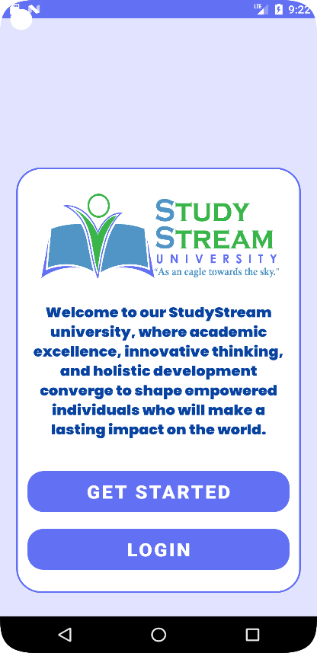
OPENING
Background of the Application
Our mobile app is made up of four pages, one of which is a login page, to ensure an intuitive user interface. Users can easily browse because of the clarity and simplicity with which each page has been developed. The existence of buttons on each page makes it simple for users to go back to the home page or to the next page, improving user flow overall.

Slide 5





TARGET AUDIENCE & SCOPE
STUDENTS
LECTURER
ADMIN

Slide 6

INTRODUCING
THE APP
EASY TO USE
ACCESS EASIER
WORK ANYTIME
PERFECT FOR YOU
USER-FRIENDLY UI/UX
SUPPORT

Slide 7

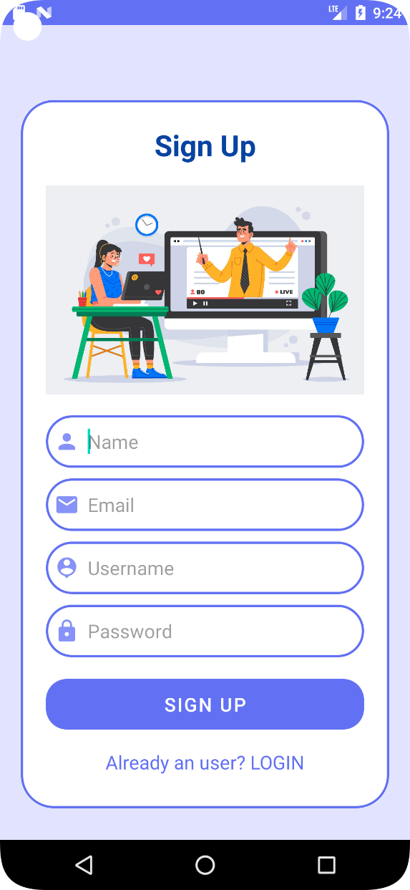
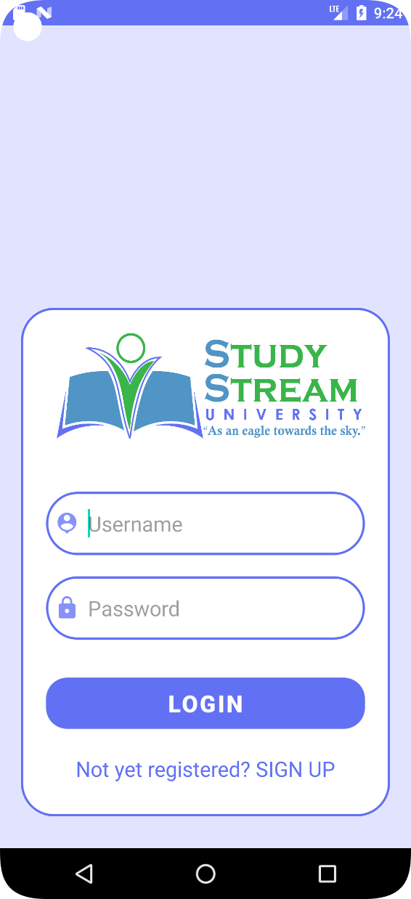
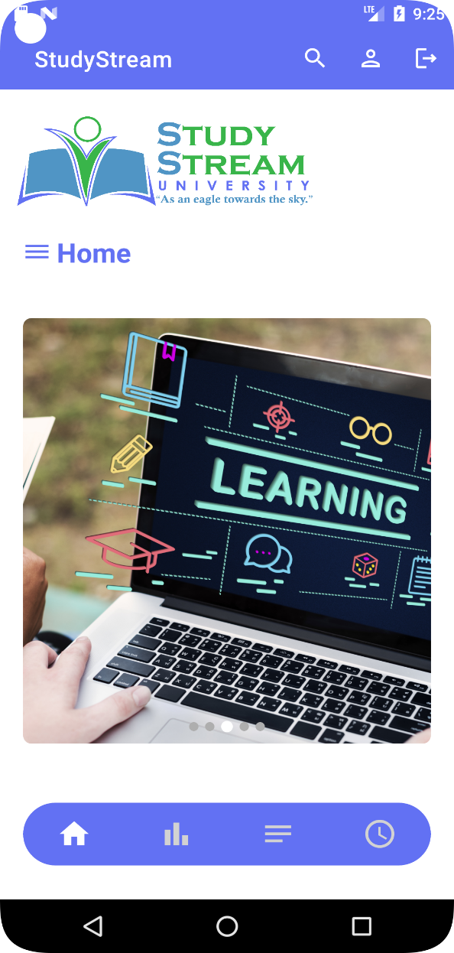
FEATURES OF THE APP
Opening
Sign UP
Log in
Home Page

Slide 8
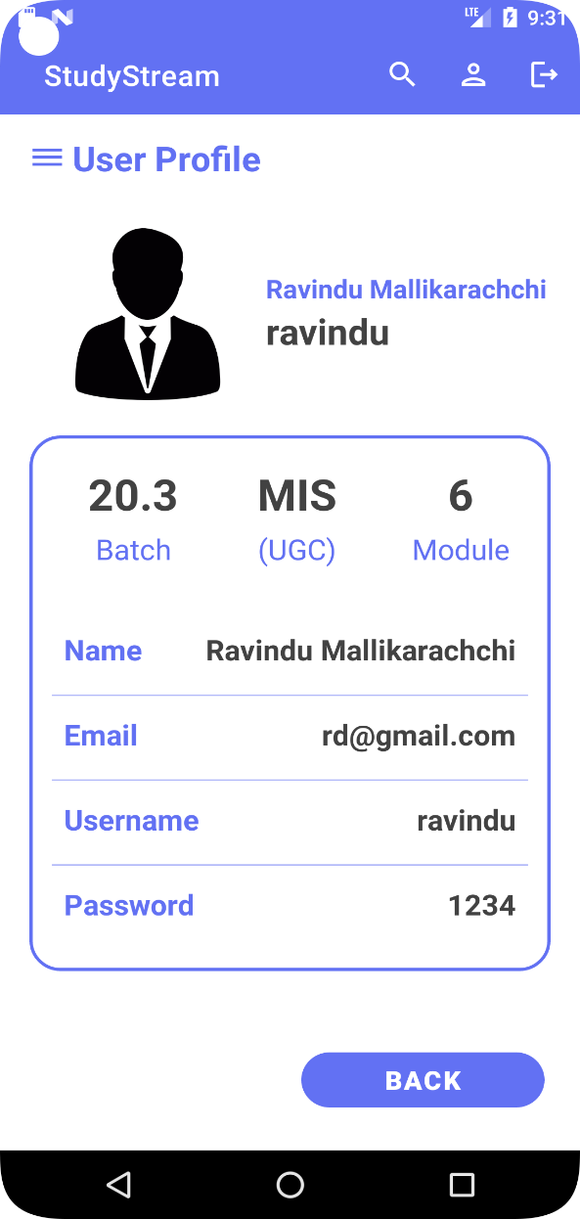
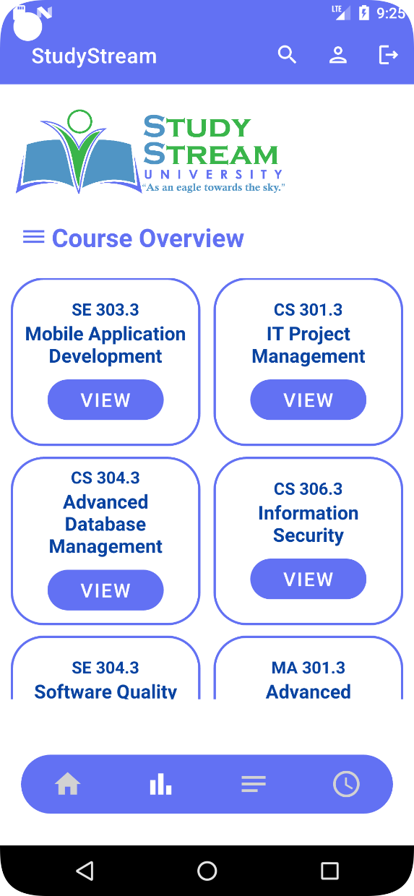
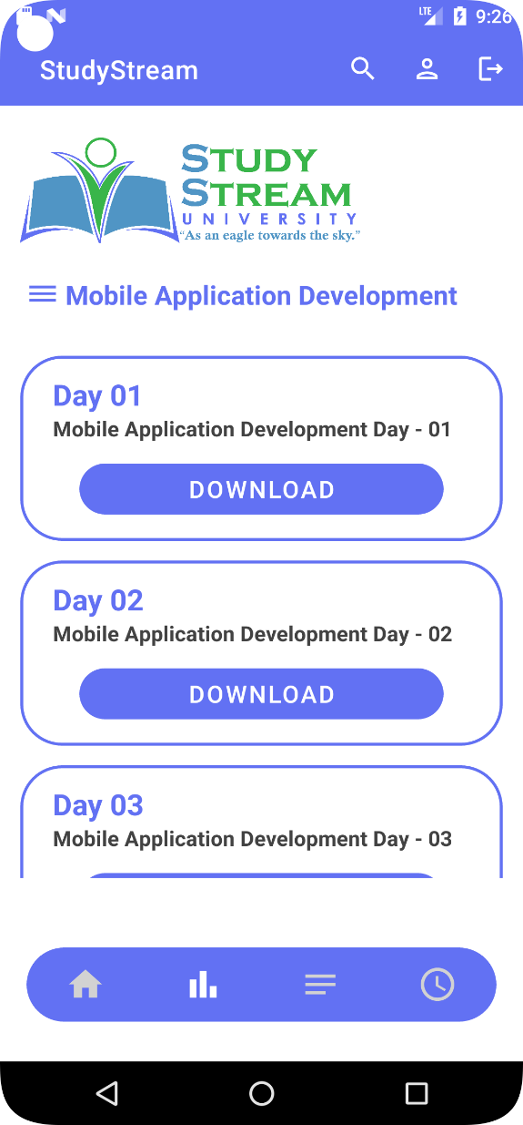
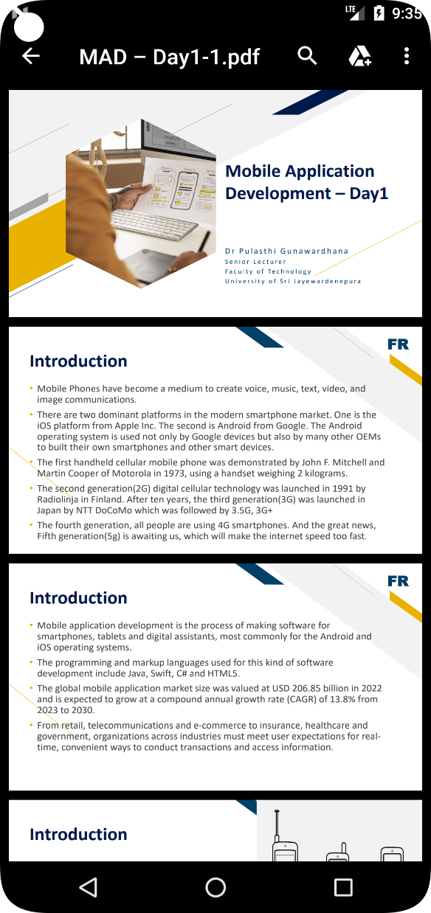
FEATURES OF THE APP
Access Lecture Material
Profile
Dashboard
Module

Slide 9
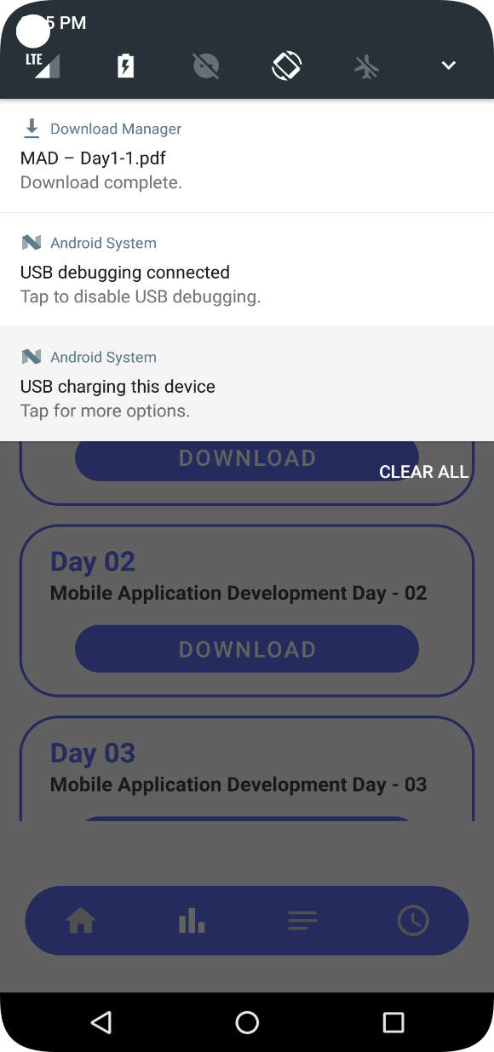
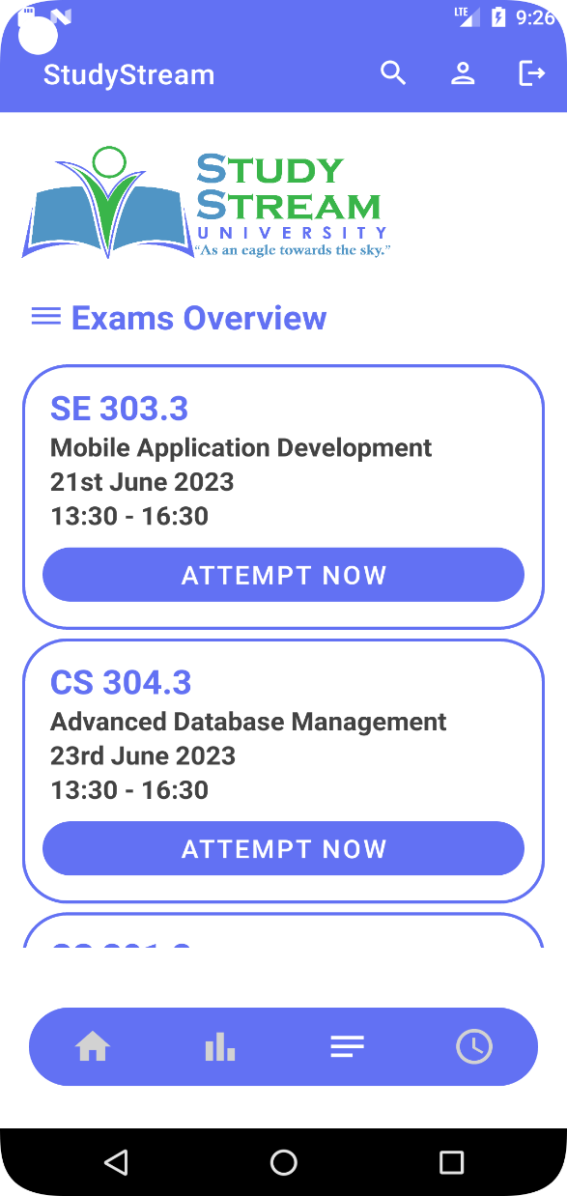
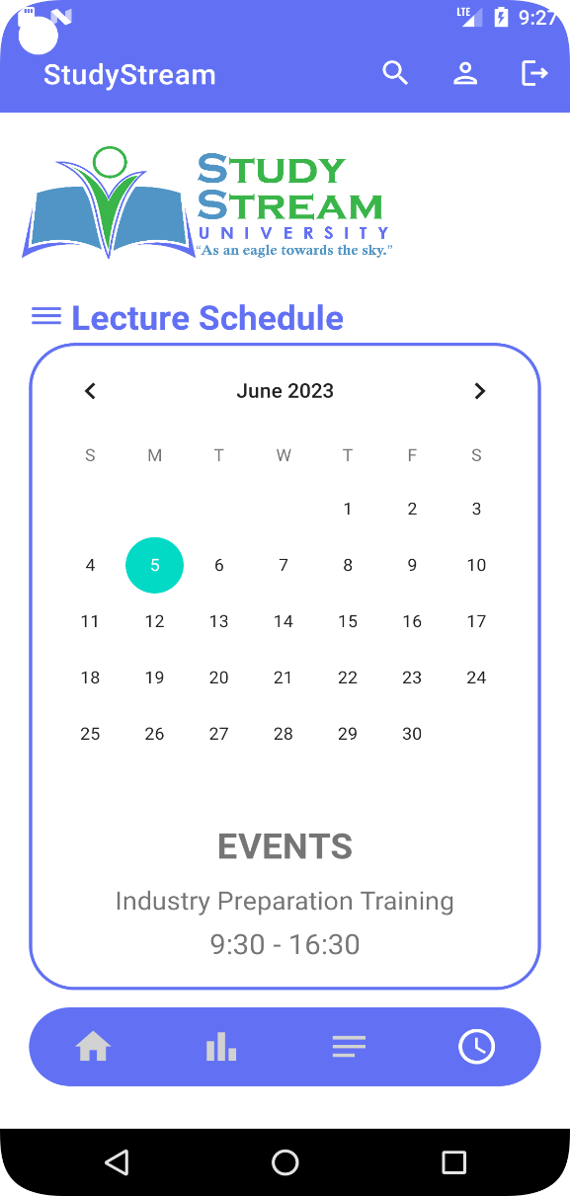
FEATURES OF THE APP
Download Lecture Material
Lecture Schedule
Calendar
Exam Overview

Slide 10
FEATURE
FOR USERS
Course Overview
Calendar view
Access lecture Materials
DATA PREVIEW
Access exam and lecture schedules
CALCULATION

Slide 11

Q & A

Slide 12
THANK YOU

